Slide 1
Digital Footprints
Online Privacy and Security

Slide 2
Digital footprints
Digital footprints refer to the traces or records of activities that individuals leave behind while using digital devices and platforms.
Notes:
These include wide range of data, such as browsing history, social media interactions, online purchases, location information, and more.
Social Media Activity: Posts, comments, likes, shares, and messages on social media platforms create a digital trail of one's online interactions. For example, a series of posts and comments on a political issue can reflect an individual's stance and interests in social and political matters.

Slide 4
Online Privacy and Security
Focus on protecting individuals' personal information, data, and digital assets from unauthorized access, misuse, and exploitation.
Notes:
Online privacy refers to the right of individuals to control the collection, use, and disclosure of their personal information when engaging in activities on the internet.
Online security involves the implementation of measures and practices to safeguard digital assets, such as data, devices, and networks, from cyber threats and attacks.

Slide 5
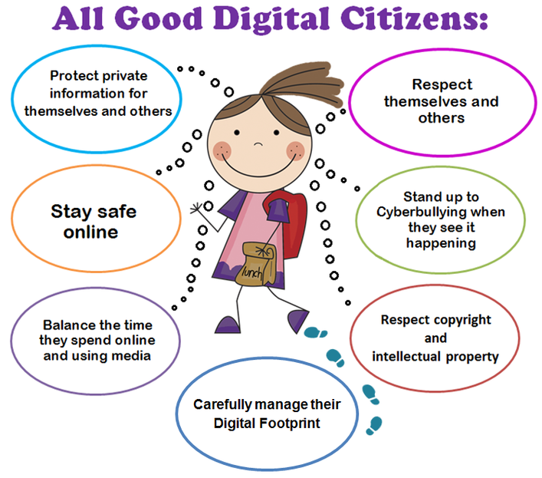
Expectations of a good digital citizenship
Notes:
Treat others with kindness, empathy, and respect in all online interactions
Protecting Privacy: Safeguard personal information and respect the privacy of others.
Prioritize online safety and security by implementing strong passwords, 2FA
Digital Footprint Management: Understand the implications of digital footprints and manage online presence responsibly.
Ethical Use of Technology: Use technology ethically and responsibly, respecting terms of service, user agreements, and community guidelines.
Etiquette refers to the customary code of polite behavior and social conventions observed in various contexts, including personal, professional, and social interactions. Etiquette guides individuals on how to conduct themselves appropriately, show respect for others, and navigate social situations with grace and consideration.

Slide 6
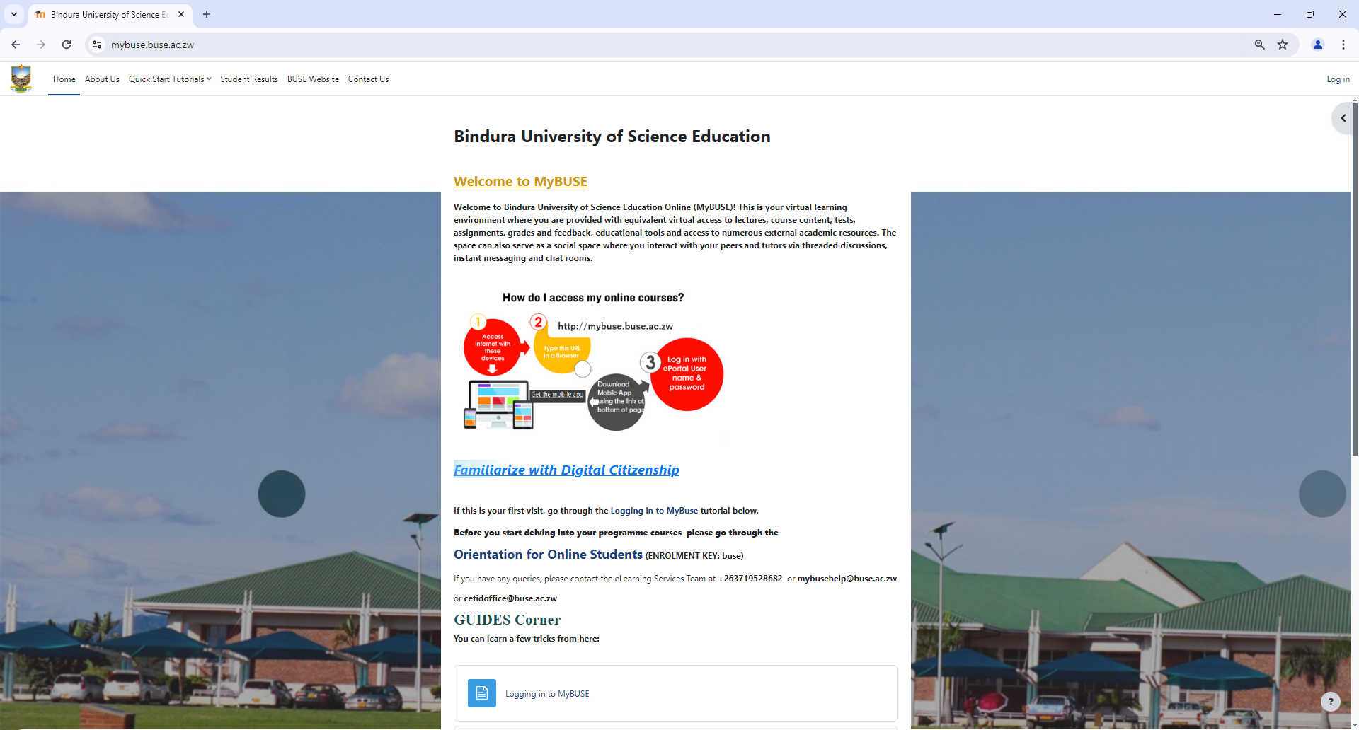
For more

